Slide 1
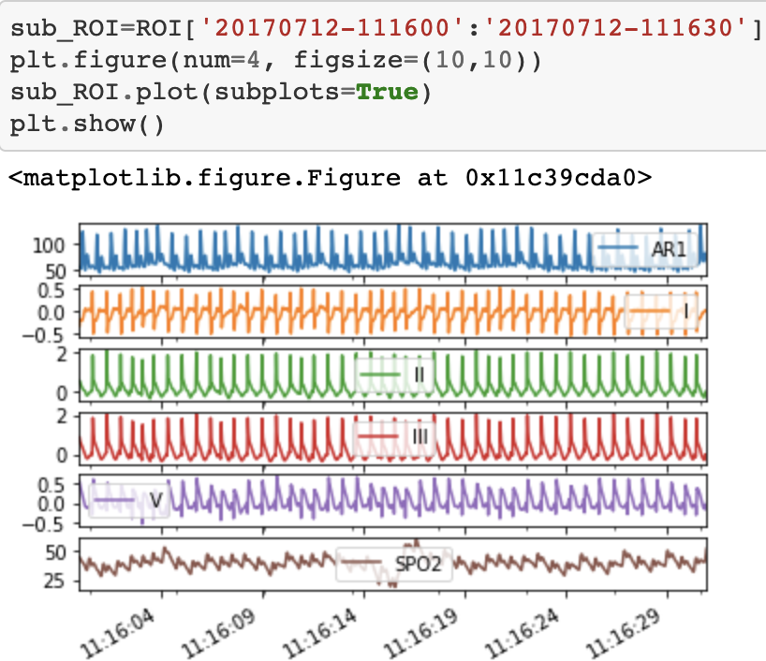
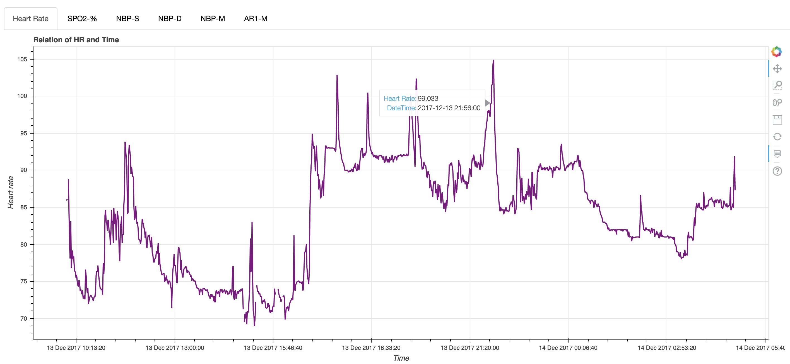
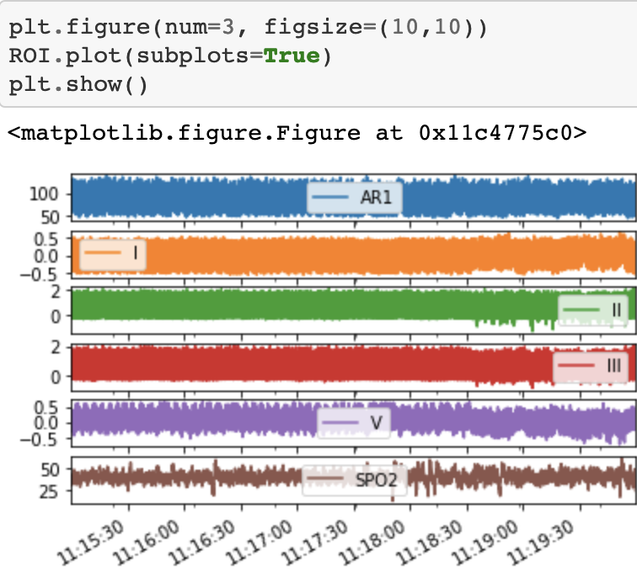
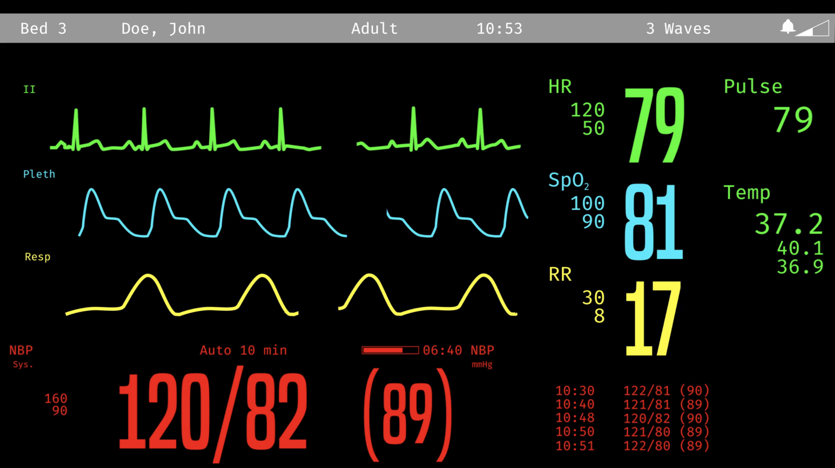
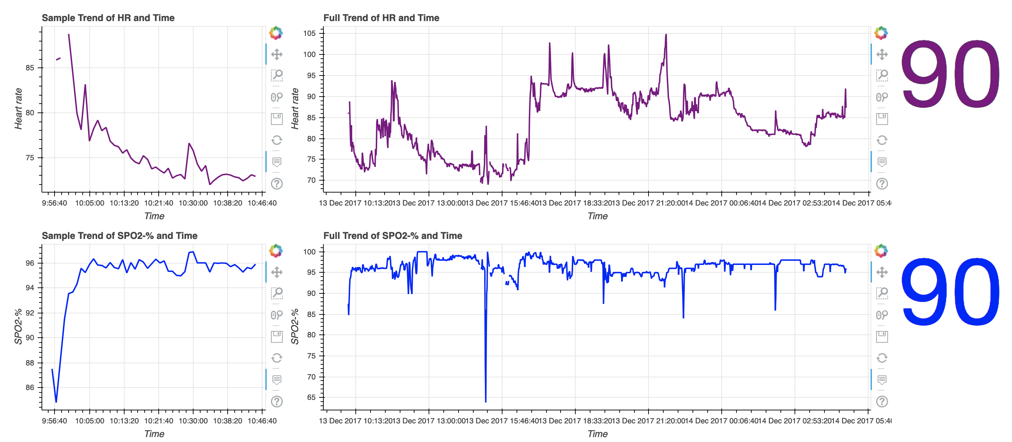
Waveform visualization tool for Critical Care Medicine By: Tianbo Ma, Queen’s School of Computing Supervisors: Dr. Phil Laird, Dept of Critical Care Medicine Dr. David Maslove, Dept of Critical Care Medicine
1.Introduction
The Intensive Care unit of the Kingston Health Sciences Centre (KHSC) is a 33-bed unit caring for critically ill patients with severe infections, massive strokes, trauma, and other life-threatening conditions. Physiologic signals from bedside monitors are continuously recorded at 240 Hz, including arterial and venous pressures, cardiac electrical activity, and blood oxygen saturation. All of this generates a tremendous amount of data, the correct, real-time interpretation of which is vital to ensuring the best possible outcomes for the sickest patients in the hospital. As part of a multi-year project, a large amount of high frequency physiological data is collected on critically ill patients admitted to the intensive care unit at KHSC. At the moment this dataset exceeds 20 TB and is growing by approximately 16 GB per day. This dataset is being mined for novel physiological signatures which have the potential to better predict the evolution or development of disease states as well as measure and predict response to therapy.
3.Problem
To better understand the physiological waveforms, the tool should be a user interface which allows data manipulation on the plot. An issue with a typical plotting tool such as Matlab is static plotting, which requires code input to view different parts of data. And the information it shows isn’t exactly useful for exploration.
First Implementation
The first implementation allows for viewing each record with tabs. It allows the user to zoom in, view area of interest, move the plot, and hover on a point to check data. There are different tabs for different records that the user can click on.
2.Objective
The goal of this project is to develop a suite of visualization tools which will allow for exploration of the physiological waveforms. The tool should allow for overview of an entire record with the ability to zoom in on regions of interest. It should be designed to look like an actual bedside monitor in an ICU, which looks like the following.
4.Solution
The tool will be developed in Python, using the Bokeh library to design the UI. The Bokeh library will provide a variety of tools that can visualize, stream, and adjust data. Jupyter notebook is used as a development environment for convenient integration to the lab’s Jupyter Hub.
Second Implementation
The second implementation is an improvement upon the first, with the added ability of streaming the data. Instead of tabs, all records are displayed in an attempt to simulate an actual bedside monitor. The
first column shows a live view of the data that is streaming, the second column shows the trend of the data streamed so far, and the final column shows the mean value of each record.
5.Results and Future Improvements
The tool is able to display the data clearly and correctly. Two implementations were created for different purposes. The first implementation is a static view of the data, and the second implementation streams the data. Users no longer have to code a slice on the data in order to view different segments. They can now zoom in by scrolling their mouse wheel or by using the cursor to select an area of interest. Future improvements include but are not limited to automated flagging/feature detection of interesting events and signals using algorithms supplied by the research team, and animation of historical signals leading up to marked events of interest

